Slide 1
Clustering For Customer Segmentation & Understanding
Domain: Machine Learning
Creator: Rumanshu Chandekar
Shreyas Dongre
Date: 30.04.2024

Slide 2
Objective:
Development of a predictive model for clustering and segmenting customers to enhance understanding and improve targeted strategies. The model will identify distinct customer segments based on behavior and demographics, enabling tailored marketing efforts, better resource allocation, and improved customer engagement. This approach aims to enhance customer satisfaction, predict future trends, and drive business growth through personalized experiences.
Benefits:
Identifies distinct customer segments.
Provides better insights into customer behaviors and preferences.
Enhances targeted marketing efforts.
Improves resource allocation and management.

Slide 3
Data Sharing Agreement:
Explanation CUST_ID: Unique identifier for each customer.
BALANCE: The balance amount on the customer's account.
BALANCE_FREQUENCY: How frequently the balance is updated.
PURCHASES: Total amount of purchases made.
ONEOFF_PURCHASES: Number of one-off purchases.
INSTALLMENTS_PURCHASES: Number of purchases made in installments.
CASH_ADVANCE: Amount of cash advances taken.
PURCHASES_FREQUENCY: Frequency of purchases.
ONEOFF_PURCHASES_FREQUENCY: Frequency of one-off purchases.
PURCHASES_INSTALLMENTS_FREQUENCY: Frequency of installment purchases.
CASH_ADVANCE_FREQUENCY: Frequency of cash advances.
CASH_ADVANCE_TRX: Number of cash advance transactions.
PURCHASES_TRX: Number of purchase transactions.
CREDIT_LIMIT: Credit limit of the customer.
PAYMENTS: Number of payments made by the customer.
MINIMUM_PAYMENTS: Minimum number of payments required.
PRC_FULL_PAYMENT: Percentage of full payments made.
TENURE: Tenure of the customer in months.

Slide 4
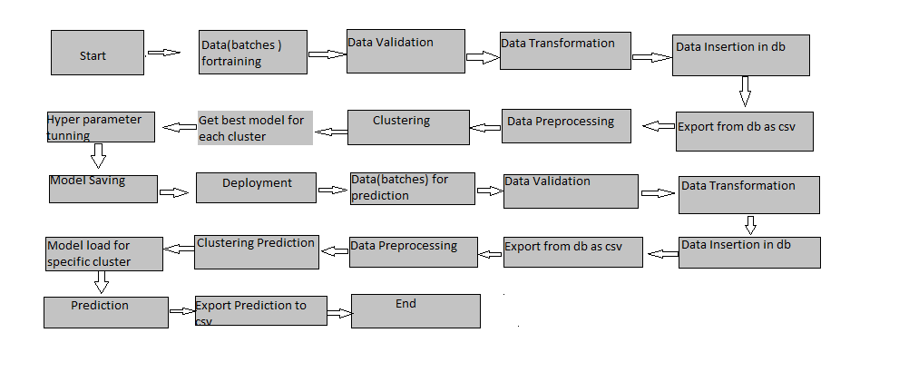
Architecture

Slide 5
Data Validation and Data Transformation:
Number of Columns – Validate the number of columns in the files. Check if the number of columns in the file matches the expected number (18 columns). Files with the correct number of columns are processed further. Files with an incorrect number of columns are moved to the other folder.
Name of Columns - Ensure that the column names match those specified in the schema file. Compare the column names in the file with the column names in the schema file. Files with matching column names are processed further. Files with non-matching column names are moved to the other folder.
Data type of columns - Validate the data types of the columns as specified in the schema file. Check the data types of the columns when inserting the files into the database. Files with correct data types are processed further. Files with incorrect data types are moved to the other folder.
Null values in columns - Identify and handle columns with all NULL or missing values. Check each column in the file for NULL or missing values.
Summary:
This Data Validation and Data Transformation process ensures that the dataset is accurate, consistent, and conforms to the specified schema. By validating file names, column counts, column names, data types, and handling NULL values, we maintain the integrity and quality of the data.

Slide 6
Data Insertion in Database:
Table creation -Table name “Customer Segmentation" is created in the database for inserting the files. If the table is already present, then new files are inserted in the same table.
Insertion of files in the table - All the files in the folder are inserted in the abov-created table. If any file has invalid data type in any of the columns, the file is not loaded in the table.
Additional Considerations :
Error Handling: Implement error handling to catch and log any issues during the data insertion process.
Data Cleaning: Before inserting data, ensure that any missing values or outliers are handled appropriately.
Ensures Data Integrity: Validating data types and formats ensures that only clean and consistent data is inserted into the database.
Scalability: Ensuring the database and data processing pipeline can handle large volumes of data efficiently

Slide 7
Model Training:
Data Export from Db :
Export the accumulated data from the database in CSV format for model training. Steps: Connect to the database. Query the data from the Customer Segmentation table. Export the queried data to a CSV file.
Data Preprocessing:
Prepare the data for model training by performing EDA, handling missing values, encoding categorical variables, and scaling the data.
Performing EDA to get insight of data like identifying distribution , outliers ,trend
among data etc.
Check for null values in the columns. If present impute the null values.
Encode the categorical values with numeric values.
Perform Standard Scalar to scale down the values.
Next Steps:
Model Training: Train clustering models using the preprocessed data.
Model Evaluation: Evaluate the performance of the clustering models using appropriate metrics.
Cluster Analysis: Analyze the clusters to understand customer segments and derive actionable insights.
Deployment: Deploy the clustering model to a production environment for real-time customer segmentation.

Slide 8
Data Preprocessing: This involves comprehensive data cleaning, normalization, and transformation steps to prepare the data for clustering. Techniques such as feature selection and dimensionality reduction (e.g., PCA) are employed to enhance the performance of the clustering algorithm.
Evaluation Metrics: Besides the AUC score, other metrics such as Silhouette Score, Davies-Bouldin Index, and Inertia are used to evaluate the clustering performance. These metrics provide a holistic view of the quality and effectiveness of the clustering process.
Visualization: Visual representations of the clusters are created using scatter plots, heatmaps, and dendrograms. The elbow plot and 2D&3D are used to determine the optimal number of clusters, providing a clear and intuitive understanding of the clustering process.
Deployment: The final models are deployed in a production environment to enable real-time customer segmentation. An API or a web interface may be developed to interact with the clustering model and make predictions, facilitating seamless integration with existing systems.
Future Work: Continuous monitoring and retraining of the models are planned to adapt to new data and evolving customer behaviors. Exploration of other clustering algorithms, such as DBSCAN and Agglomerative Clustering, is also considered for future improvements. Integration with customer relationship management (CRM) systems is envisioned to provide enhanced customer insights and drive business value.

Slide 9
Clustering -
The project aims to enhance customer segmentation by creating clusters in preprocessed data using the K-means algorithm. We determine the optimal number of clusters with the elbow plot method. The process involves data cleaning, normalization, transformation, and possibly PCA for dimensionality reduction. The trained K-means model is saved for future predictions, ensuring efficient replication and real-time application.
Model Selection -
After creating the clusters, the next step is to find the best predictive model for each cluster. For this purpose, we use two hyper-tuned algorithms for each cluster. The performance of these models is evaluated using the Area Under the Curve (AUC) score, a robust metric for assessing the quality of classification models. The model with the highest AUC score is selected as the best model for each cluster. These selected models are then saved for use in future predictions, ensuring that the most accurate and reliable models are employed for customer segmentation.

Slide 10
Prediction:
Batch Processing of Testing Files: Testing files are shared in batches. Each batch undergoes the same validation operations, data transformation, and data insertion processes as the training data. This ensures consistency and reliability in the data used for prediction.
Data Export and Preprocessing: The accumulated data from the database is exported in CSV format for prediction. Data preprocessing techniques are applied to the exported data to ensure it is suitable for clustering and prediction. This includes steps such as data cleaning, normalization, and transformation to prepare the data for accurate clustering.
Loading the K-means Model: The K-means model created during the training phase is loaded. Clusters for the preprocessed data are predicted using this model. The K-means algorithm helps in identifying distinct groups within the data, which is crucial for targeted customer segmentation.
Cluster-Based Model Loading and Prediction: Based on the predicted cluster number, the respective model for that cluster is loaded. This model is then used to predict the data for that specific cluster. This step ensures that each cluster is analyzed with a model tailored to its unique characteristics, leading to more accurate predictions.
Saving and Sharing Predictions: Once predictions are made for all clusters, the results are saved in CSV format. These CSV files are then shared with the relevant stakeholders for further analysis or use. This step ensures that the predictions are accessible and can be utilized for decision-making processes.

Slide 11
Additional Relevant Information:
Validation Operations: Ensuring data integrity and quality throughout the process is crucial. Validation operations help in maintaining the accuracy and reliability of the data used for predictions.
Data Transformation: Includes normalization, scaling, and other necessary transformations to prepare the data for clustering. Proper data transformation is essential for the effectiveness of the clustering algorithm.
Model Management: Efficient loading and utilization of models based on cluster predictions ensure accurate and relevant predictions. This involves managing multiple models and selecting the appropriate one based on the cluster number.
Real-time Application: The entire process is designed to be efficient and replicable, allowing for real-time customer segmentation and prediction. This ensures that the system can adapt to new data and provide timely insights.
Continuous Improvement: Continuous monitoring and retraining of the models are planned to adapt to new data and evolving customer behaviors. Exploration of other clustering algorithms, such as DBSCAN and Agglomerative Clustering, is also considered for future improvements.
Integration with CRM Systems: Integration with customer relationship management (CRM) systems is envisioned to provide enhanced customer insights and drive business value. This integration can help in leveraging the predictions for better customer engagement and personalized marketing strategies.

Slide 12
Q&A:
Q1)How did you handle missing or incomplete data?
A: Missing or incomplete data was handled through imputation techniques, such as filling missing values with the mean or median for numerical data, and the most frequent value for categorical data.
Q2) What preprocessing steps were taken before clustering?
A: Preprocessing steps included data cleaning, normalization, and transformation to ensure the data was suitable for clustering. This helped in improving the accuracy and efficiency of the clustering process.
Q3) How did you determine the optimal number of clusters?
A: The optimal number of clusters was determined using the elbow plot method, which helps in identifying the point where the within-cluster sum of squares (WCSS) starts to diminish significantly.
Q4) What metrics were used to evaluate the clustering performance?
A: Metrics such as silhouette score and Davies-Bouldin index were used to evaluate the clustering performance and ensure the quality of the clusters.
Q5) How were the predictions shared with the client?
A: Once the predictions were made for all clusters, the results were saved in CSV format and shared with the client for further analysis and use.
Q6) What are the future steps planned for this project?
A: Future steps include continuous monitoring and retraining of the models to adapt to new data, exploring other clustering algorithms for potential improvements, and integrating the system with CRM tools for enhanced customer insights.

Slide 13
Q 7) How was training done or what models were used?
A-Before dividing the data into training and validation sets, we performed clustering using the KMeans algorithm to segment the data into clusters. The training and validation data were then divided according to these clusters. Scaling was performed on both the training and validation data. The KMeans algorithm was used for clustering, and based on the recall, the final model was selected for each cluster. These models were then saved for future use on AWS EC2 instances.
Q 8) How was prediction done?
A-The testing files are provided by the client. We follow the same lifecycle until the data is clustered using the KMeans algorithm. Based on the cluster number, the corresponding model is loaded to perform predictions. In the end, we accumulate the data of predictions.

Slide 14
THANK YOU!

